Slide 1

NVIDIA PE CHECKING YR 07.27

Slide 2
Tracking Yield Rate day shift (0h 07/26 – 0h30 07/27)
Product Line | Model Name | Group Name | Q'ty | First Fail Qty | Fail Qty | Pass Qty | 27-Jul |  | 26-Jul |  | 25-Jul |  | Target YR | Target RTR
 |  |  |  |  |  |  | Yield Rate | First Pass Yeild | Yield Rate | First Pass Yeild | Yield Rate | First Pass Yeild
GOLDENEYE | SFG025080 | FT | 496 | 17 | 1 | 495 | 99.80% | 96.57% |  |  |  |  | 98.50% | 95.00%
 |  | ICT | 1248 | 2 | 2 | 1246 | 99.84% | 99.84% |  |  |  |  | 98.50% | 95.00%
HABOOB 6DX | 900-9X675-0076-MB0 | CTO | 6239 | 42 | 6 | 6233 | 99.90% | 99.33% | 99.78% | 99.00% | 99.82% | 99.27% | 98.50% | 95.00%
 | SFG003707 | FT | 5252 | 245 | 42 | 5210 | 99.20% | 95.34% | 99.07% | 95.01% | 99.07% | 95.23% | 98.50% | 95.00%
 |  | ICT | 5761 | 30 | 15 | 5746 | 99.74% | 99.48% | 99.48% | 99.72% | 99.82% | 99.65% | 98.50% | 95.00%
IRIS 8 | SFG715305 | FT | 4690 | 329 | 70 | 4620 | 98.51% | 92.99% | 98.61% | 93.50% |  |  | 98.50% | 95.00%
 |  | ICT | 7352 | 47 | 15 | 7337 | 99.80% | 99.36% | 99.84% | 99.41% | 99.88% | 99.52% | 98.50% | 95.00%
MOONRAKER BF-3 | 930-9DAX5-0015-000 | CTO | 622 | 8 | 0 | 622 | 100.00% | 98.71% |  |  |  |  | 98.50% | 95.00%
 | SFG155171 | ICT | 339 | 5 | 3 | 336 | 99.12% | 98.53% |  |  |  |  | 98.50% | 95.00%
TOPAZ 7 | 900-9X7AH-0078-DTZ | CTO | 1508 | 27 | 1 | 1507 | 99.93% | 98.21% | 99.90% | 97.88% | 99.67% | 97.99% | 98.50% | 95.00%
 | SFG404126 | FT | 6333 | 216 | 28 | 6305 | 99.56% | 96.59% | 99.65% | 96.47% | 99.43% | 95.52% | 98.50% | 95.00%
 |  | ICT | 6198 | 23 | 10 | 6188 | 99.84% | 99.63% | 99.72% | 99.53% | 99.77% | 99.70% | 98.50% | 95.00%
TOPAZ 8 | SFG024965 | FT | 4392 | 395 | 94 | 4298 | 97.86% | 91.01% | 97.79% | 91.26% | 96.76% | 87.79% | 98.50% | 95.00%
 |  | ICT | 4593 | 19 | 13 | 4580 | 99.72% | 99.59% | 99.66% | 99.84% |  |  | 98.50% | 95.00%
Top FPY (1) FT TOPAZ 8, (2) FT IRIS 8

Slide 3
TOP FPY 07/26

Slide 4
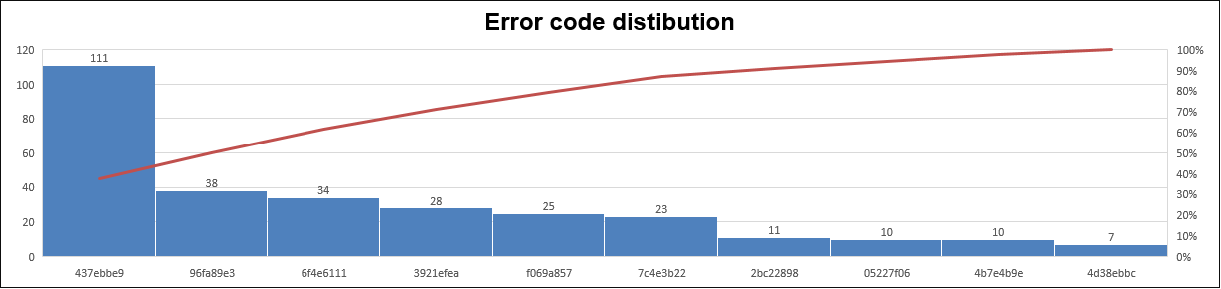
Top FPY (1) FT TOPAZ 8
ERROR_CODE | ERROR_DESC | First fail | Fail_Q’ty | Retest rate | Yield rate 07/27 | Yield rate 07/26 | Yield rate 07/25
437ebbe9 | theta_group-theta_test-FAIL-MEASUREMENT; | 111 | 41 | 1.59% | 0.93% | 4.21% | 2.76%
96fa89e3 | pcie_capacitors_group-pcie_capacitors_test-FAIL-MEASUREMENT; | 38 | 13 | 0.57% | 0.30% | 0.41% | 0.27%
6f4e6111 | initial_setup_group-uut_present-FAIL-MEASUREMENT; | 34 | 8 | 0.59% | 0.18% | 0.34% | 0.24%
3921efea | initial_setup_group-insert_uut-ERROR-ValueError; | 28 | 3 | 0.57% | 0.07% | 0.07% | 0.13%
f069a857 | pcie_test_group-link_capabilities-FAIL-MEASUREMENT; | 25 | 6 | 0.43% | 0.14% | 0.26% | 0.34%
7c4e3b22 | fan_control_group-root_complex_fan-ERROR-Exception; | 23 | 1 | 0.50% | 0.02% | 0.11% | 0.07%
2bc22898 | test_teardown-rescan_labels-FAIL-MEASUREMENT; | 11 | 0 | 0.25% | 0.00% | 0.00% | 0.00%
05227f06 | stress_group-parse_amber_results-FAIL-MEASUREMENT; | 10 | 2 | 0.18% | 0.05% | 0.11% | 0.07%
4b7e4b9e | revision_group-unbind-ERROR-ValueError; | 10 | 4 | 0.14% | 0.09% | 0.00% | 0.07%
4d38ebbc | link_group-physical_link-FAIL-MEASUREMENT; | 7 | 1 | 0.14% | 0.02% | 0.04% | 0.07%
Other |  | 98 | 15 | 1.89% | 0.34% | 2.87% | 2.66%
Total |  | 395 | 94 | 6.85% | 2.14% | 8.41% | 6.67%

Slide 5
Top FPY (1) FT IRIS 8
TE update
 | theta_group-theta_test-FAIL-MEASUREMENT;
 | TOP 1 First fail 111 pcs , R_FT 41 pcs
STATION_NAME | INPUT | First fail | DFR machine | Retest rate | Root cause | Action | Due date | Status | Owner
fox-vn-242154-bf_1 | 33 | 7 | 21.21% | 93.94%
fox-vn-244175-bf_1 | 15 | 5 | 33.33% | 93.33%
fox-vn-245018-bf_1 | 52 | 4 | 7.69% | 96.15%
Error code | pcie_capacitors_group-pcie_capacitors_test-FAIL-MEASUREMENT;
 | TOP 2 First fail 38 pcs , R_FT 13 pcs
STATION_NAME | INPUT | First fail | DFR machine | Retest rate | Root cause | Action | Due date | Status | Owner
fox-vn-226011-bf_2 | 53 | 3 | 5.66% | 100.00%
fox-vn-226011-bf_1 | 36 | 3 | 8.33% | 100.00%
fox-vn-226153-bf_2 | 41 | 2 | 4.88% | 97.56%
Error code | initial_setup_group-uut_present-FAIL-MEASUREMENT;
 | TOP 3 First fail 34 pcs , R_FT 8 pcs
STATION_NAME | INPUT | First fail | DFR machine | Retest rate | Root cause | Action | Due date | Status | Owner
fox-vn-226010-bf_2 | 41 | 2 | 4.88% | 95.12%
fox-vn-242184-bf_1 | 46 | 2 | 4.35% | 97.83%
fox-vn-244050-bf_2 | 30 | 1 | 3.33% | 86.67%

Slide 6
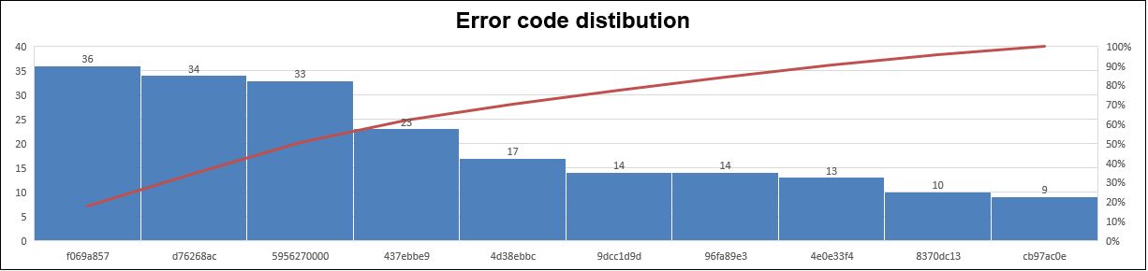
Top FPY (2) FT IRIS 8
ERROR_CODE | ERROR_DESC | First fail | Fail_Q’ty | Retest rate | Yield rate 07/27 | Yield rate 07/26
f069a857 | pcie_test_group-link_capabilities-FAIL-MEASUREMENT; | 36 | 22 | 0.30% | 0.47% | 0.50%
d76268ac | IC_A2D_temperature_group-ic_a2d_temperature_test-FAIL-MEASUREMENT; | 34 | 6 | 0.60% | 0.13% | 0.11%
5956270000 | pcie_test_group-pcie_check_error_with_clear-FAIL-MEASUREMENT; | 33 | 4 | 0.62% | 0.09% | 0.08%
437ebbe9 | theta_group-theta_test-FAIL-MEASUREMENT; | 23 | 3 | 0.43% | 0.06% | 0.00%
4d38ebbc | link_group-physical_link-FAIL-MEASUREMENT; | 17 | 5 | 0.26% | 0.11% | 0.26%
9dcc1d9d | pcie_test_group-parse_pcie_amber-FAIL-MEASUREMENT; | 14 | 2 | 0.26% | 0.04% | 0.00%
96fa89e3 | pcie_capacitors_group-pcie_capacitors_test-FAIL-MEASUREMENT; | 14 | 10 | 0.09% | 0.21% | 0.13%
4e0e33f4 | power_group-load_new_dev-ERROR-MTCRError; | 13 | 3 | 0.21% | 0.06% | 0.26%
8370dc13 | initial_setup_group-insert_uut-FAIL-MEASUREMENT; | 10 | 0 | 0.21% | 0.00% | 0.05%
cb97ac0e | power_group-first_power_on_phase-ERROR-ValueError; | 9 | 6 | 0.06% | 0.13% | 0.13%
Other |  | 126 | 9 | 2.49% | 0.19% | 0.77%
Total |  | 329 | 70 | 5.52% | 1.49% | 2.30%

Slide 7
Top FPY (2) FT IRIS 8
TE update
 | theta_group-theta_test-FAIL-MEASUREMENT;
 | TOP 1 First fail 111 pcs , R_FT 41 pcs
STATION_NAME | INPUT | First fail | DFR machine | Retest rate | Root cause | Action | Due date | Status | Owner
fox-vn-242154-bf_1 | 33 | 7 | 21.21% | 93.94%
fox-vn-244175-bf_1 | 15 | 5 | 33.33% | 93.33%
fox-vn-245018-bf_1 | 52 | 4 | 7.69% | 96.15%
Error code | pcie_capacitors_group-pcie_capacitors_test-FAIL-MEASUREMENT;
 | TOP 2 First fail 38 pcs , R_FT 13 pcs
STATION_NAME | INPUT | First fail | DFR machine | Retest rate | Root cause | Action | Due date | Status | Owner
fox-vn-226011-bf_2 | 53 | 3 | 5.66% | 100.00%
fox-vn-226011-bf_1 | 36 | 3 | 8.33% | 100.00%
fox-vn-226153-bf_2 | 41 | 2 | 4.88% | 97.56%
Error code | initial_setup_group-uut_present-FAIL-MEASUREMENT;
 | TOP 3 First fail 34 pcs , R_FT 8 pcs
STATION_NAME | INPUT | First fail | DFR machine | Retest rate | Root cause | Action | Due date | Status | Owner
fox-vn-226010-bf_2 | 41 | 2 | 4.88% | 95.12%
fox-vn-242184-bf_1 | 46 | 2 | 4.35% | 97.83%
fox-vn-244050-bf_2 | 30 | 1 | 3.33% | 86.67%

Slide 8


